Slide 1




HOPE TO SKILL
Lecture 36
Introduction To
LangChain & RAG
Artificial Intelligence Advance Course

Slide 2



Dedicated to my late Teacher, a beacon of Knowledge.
Your Guidance shaped me; now I shape others through
a free course.
YOUR LEGACY LIVES ON!

Slide 3





AI INSTRUCTORS
Dr.Irfan Malik
Dr.Sheraz Naseer
Dr.Shazia Saqib
Ramsha Imran
M.Haris Tariq

Slide 4



Previous Lecture Topics
01
Transformer Models
02
BERT
03
GPT

Slide 5
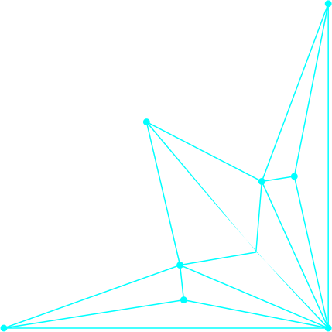
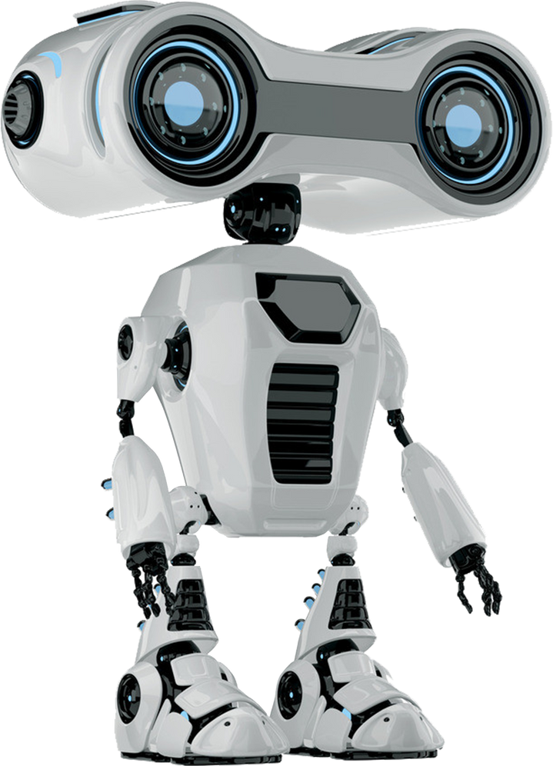

Outline
Introduction to RAG
Introduction to Langchain
Document loading

Slide 6



The Challenge of Information Overload
The digital age has led to
an explosion of information,
making it difficult to find relevant
and accurate data.
A person is overwhelmed by a
mountain of data.

Slide 7

Traditional Search Limitations
Keyword-based search often returns irrelevant results.
Difficulty in understanding user intent and context
Inability to provide comprehensive and coherent answers.

Slide 8
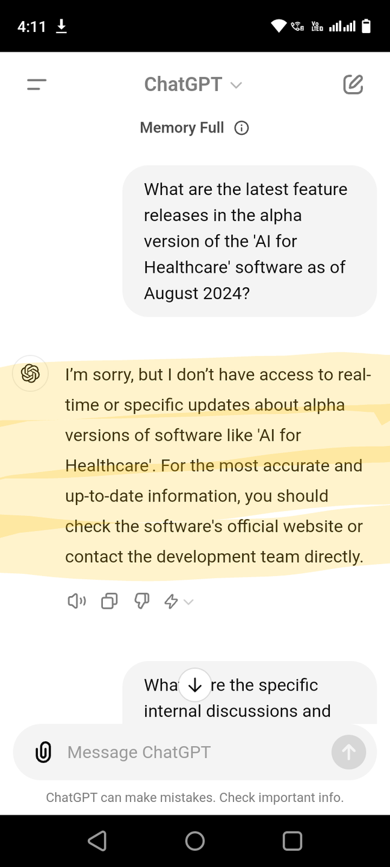
Problem with LLM
Issue: LLMs, like GPT, may not have access to realtime and latest domain specific Information.
Example: A chatbot might generate an
incorrect answer because it doesn't have
access to up-to-date or specific information

Slide 9
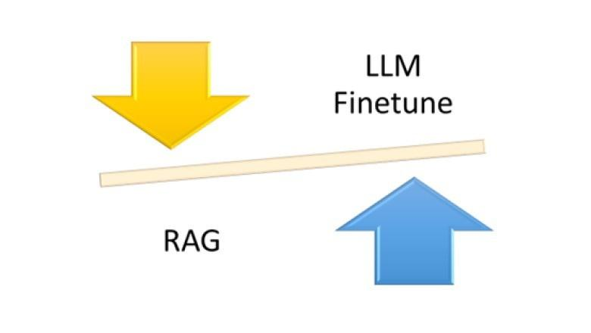
Solution
Finetune with latest data
Retrieval-Augmented Generation / In context Learning

Slide 10

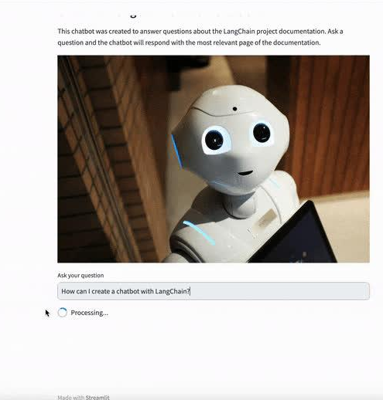
Enter the Hero - RAG
Mechanism: RAG first retrieves relevant documents or data from a knowledge base and then uses that information to generate a response.
Example: Before answering a question about current events, RAG retrieves the relevant articles and uses them to inform its response.

Slide 11

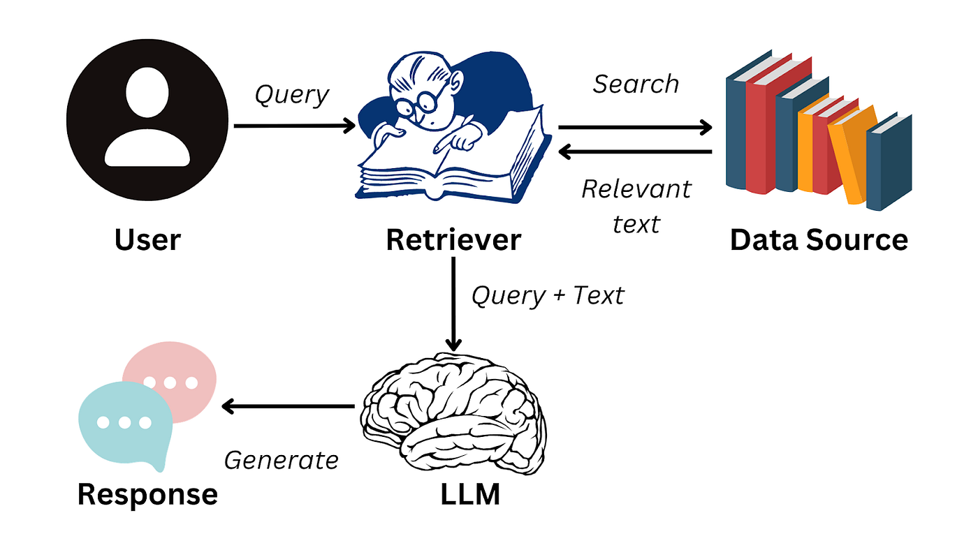
Introduction to RAG
Retrieval-Augmented Generation (RAG): Combines
retrieval-based and generation-based methods.

Slide 12
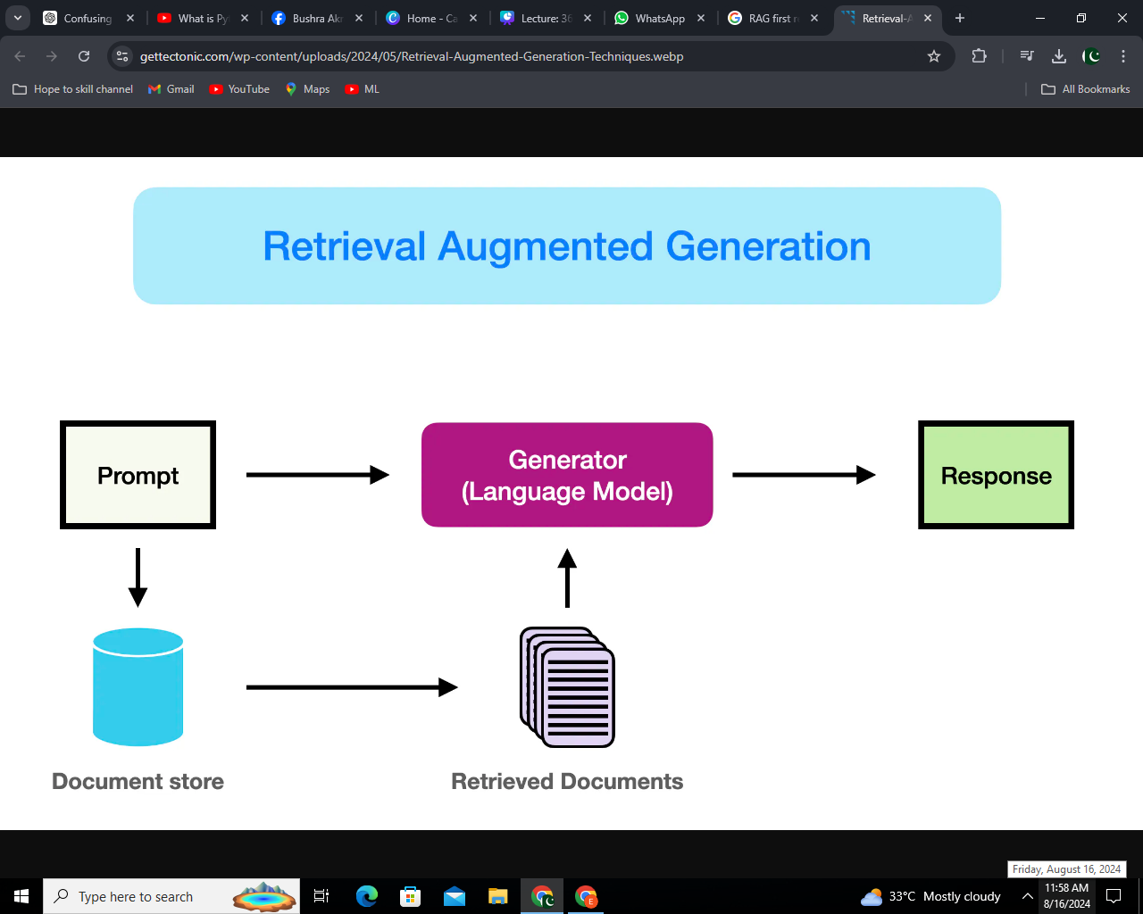
How RAG Works
Query Input: The user asks a question.
Document Retrieval: The retriever identifies relevant documents.
Response Generation: The generator crafts a response using the
retrieved information.
4. Final Output: A factually accurate and contextually relevant answer.

Slide 13
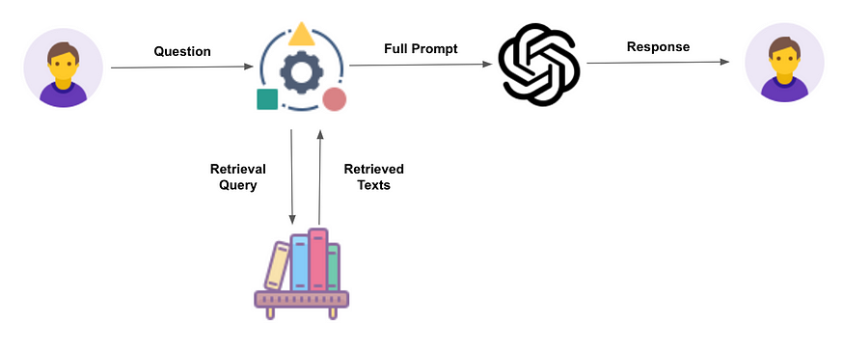
RAG Model

Slide 14
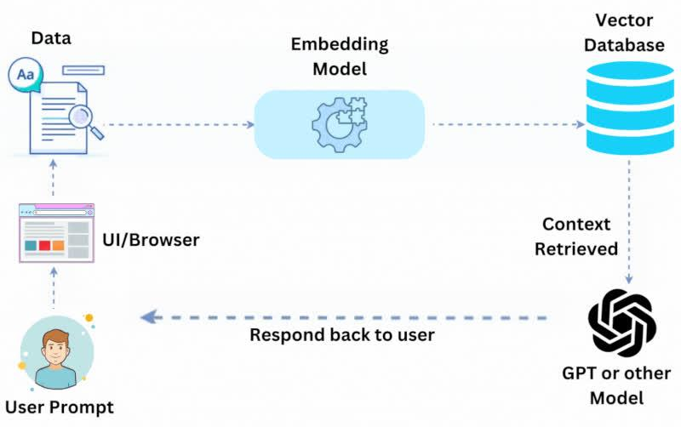
RAG Model
Retrieves relevant documents from a corpus and generates a response based on both the query and the retrieved documents.

Slide 15
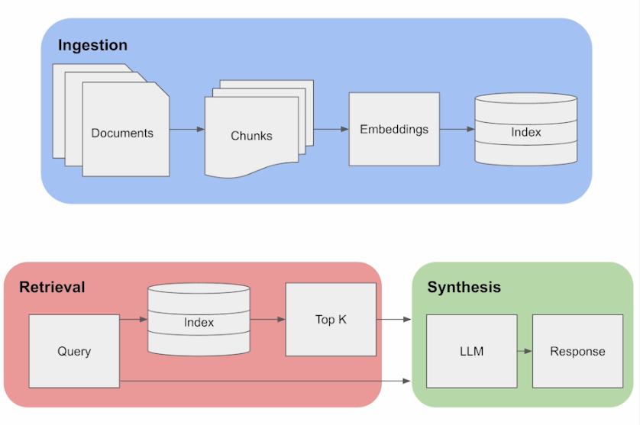
RAG Pipeline

Slide 16
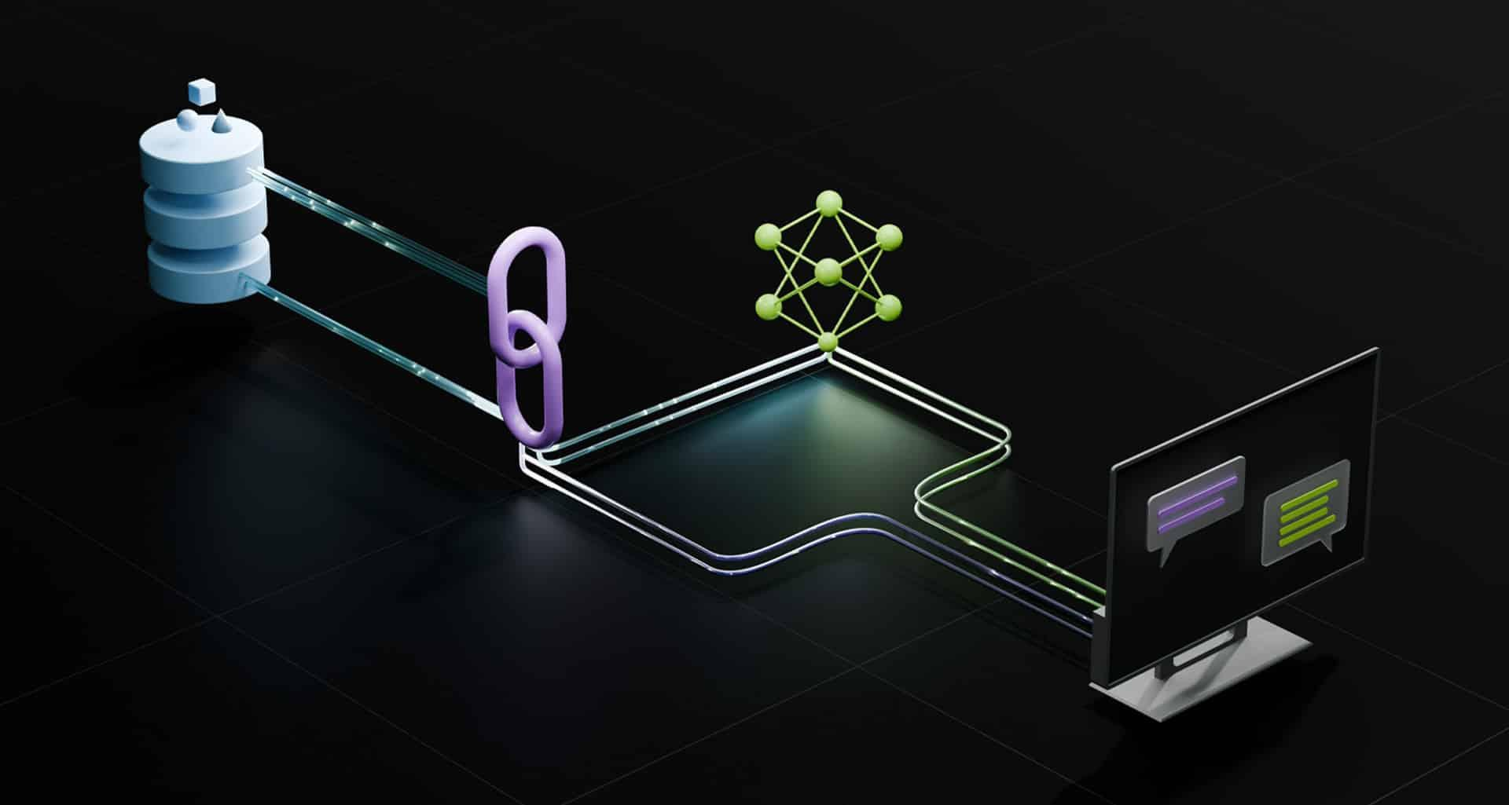
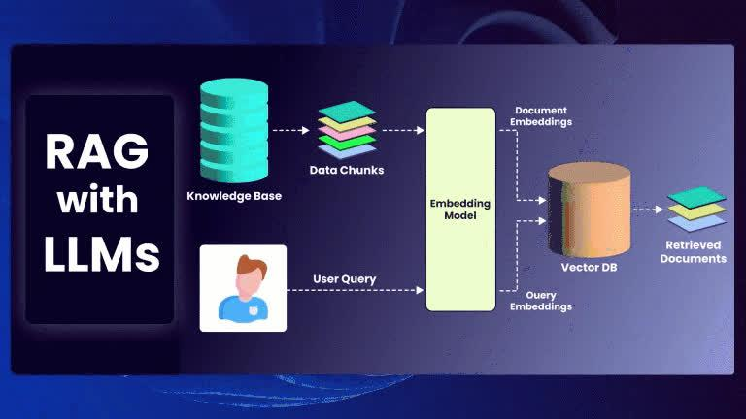
Why RAG - Enhanced Information Access
Best of Both Worlds: Combines retrieval-based
methods for vast information access and
generation-based methods for coherent,
relevant responses.

Slide 17

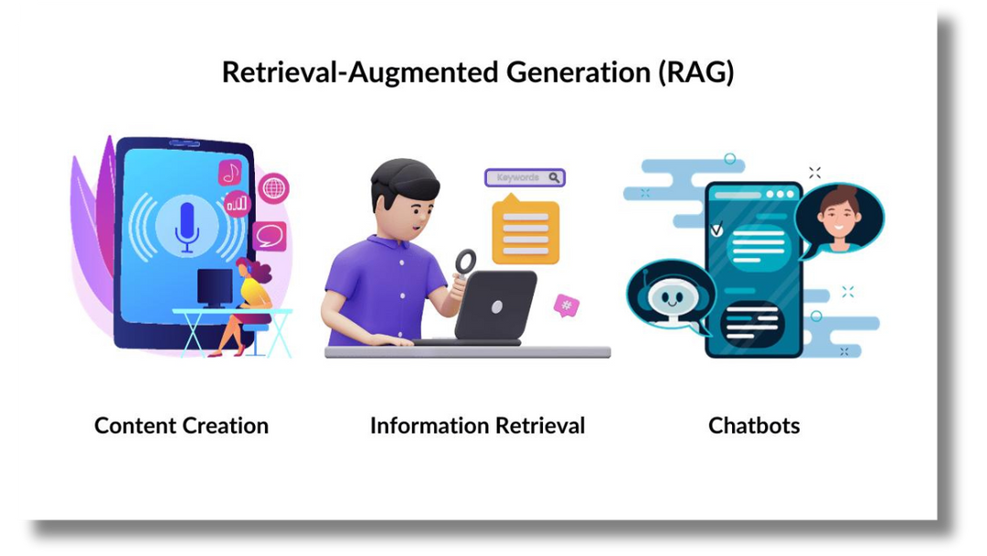
Why RAG - Enhanced Information Access
Accuracy and Relevance: Retrieves documents from a large corpus, ensuring responses are accurate and enriched with useful information.
Contextual Awareness: Maintains context by considering both the query and retrieved documents, resulting in meaningful responses.

Slide 18
RAG Pipeline

Slide 19
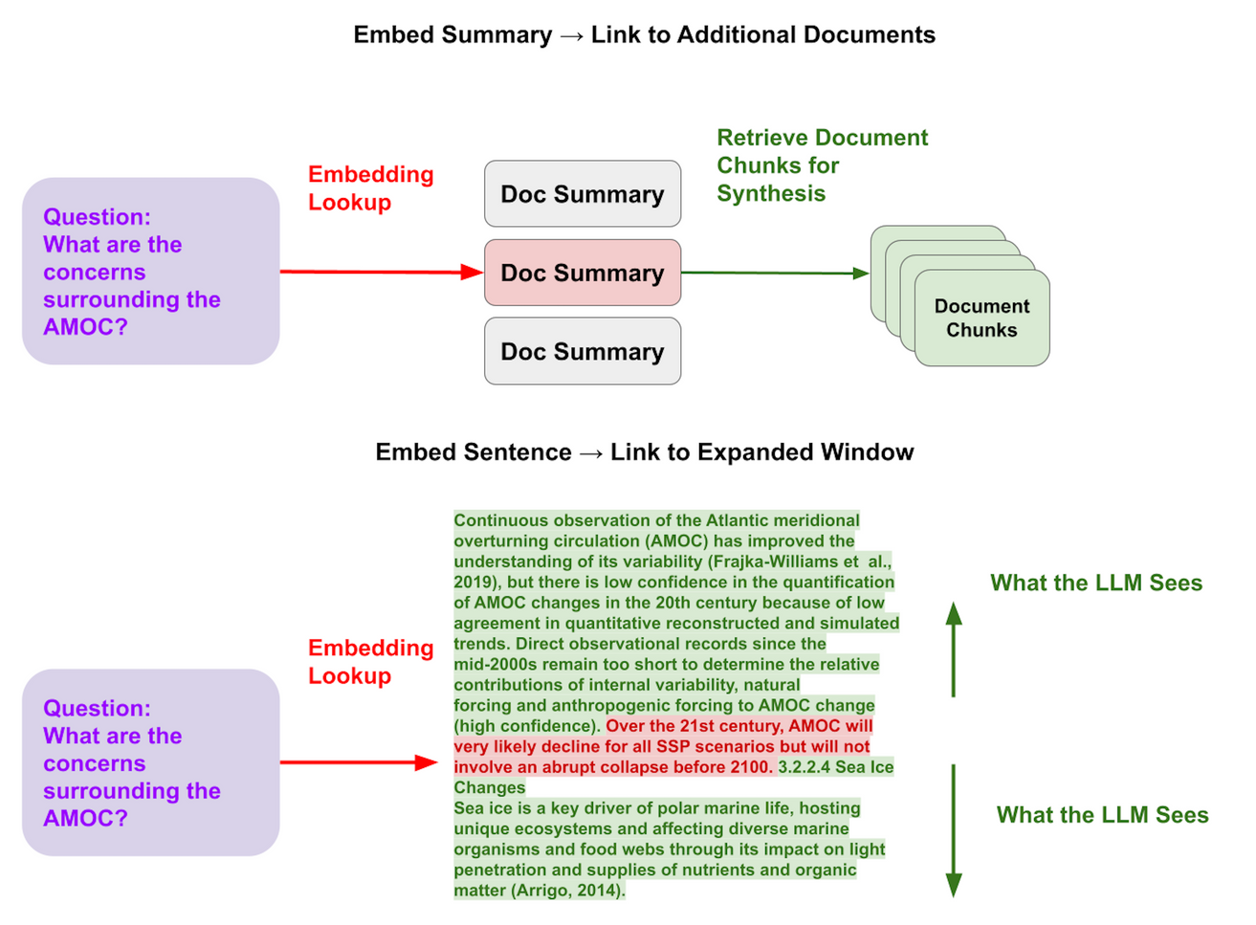
Applications
Improves the performance of tasks like question answering,
summarization, and more.

Slide 20


Advantages
1
Leverages large external knowledge bases.
2
Enhances contextual understanding.
3
Provides more accurate and relevant answers.

Slide 21
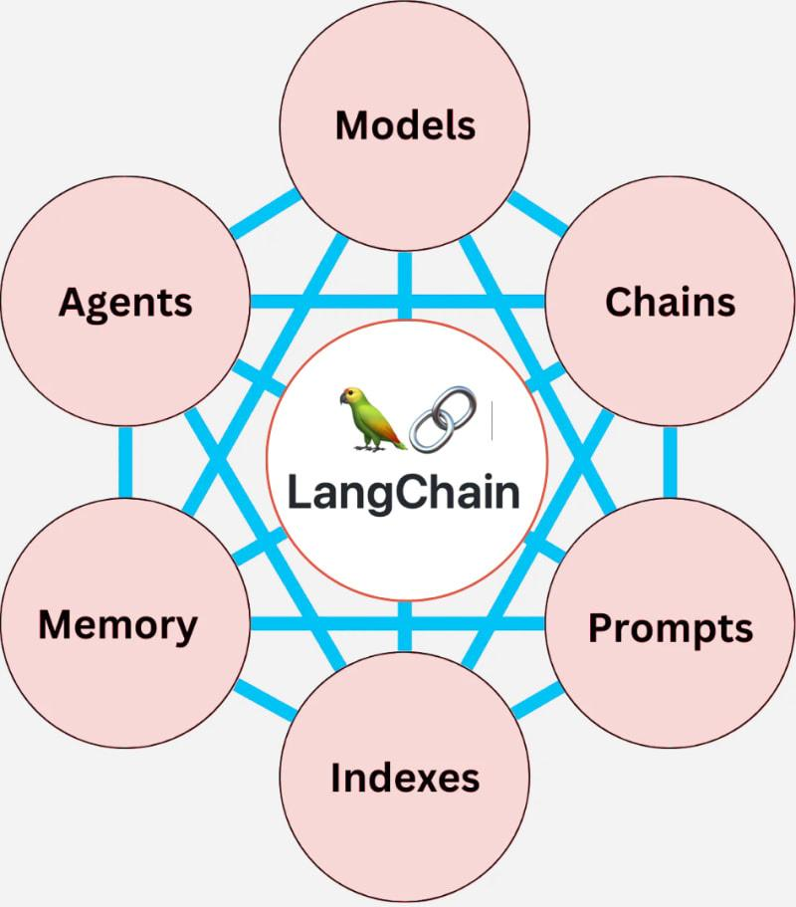
Introduction to LangChain
LangChain: A framework for building applications using language models.
Components: Includes tools for document transformation, connection to various data sources, and chaining multiple operations.

Slide 22
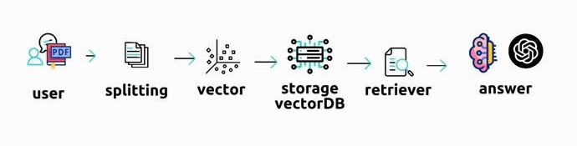
Introduction to LangChain

Slide 23
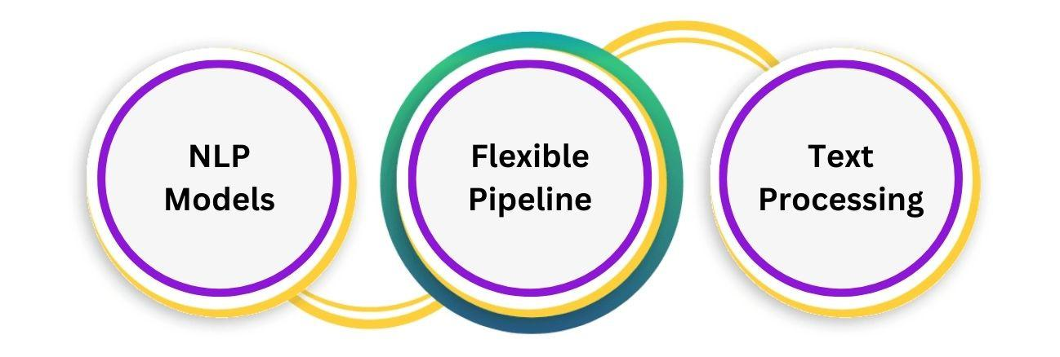
Features
Easy integration with various NLP models, flexible pipeline creation, and support for various text processing tasks.

Slide 24
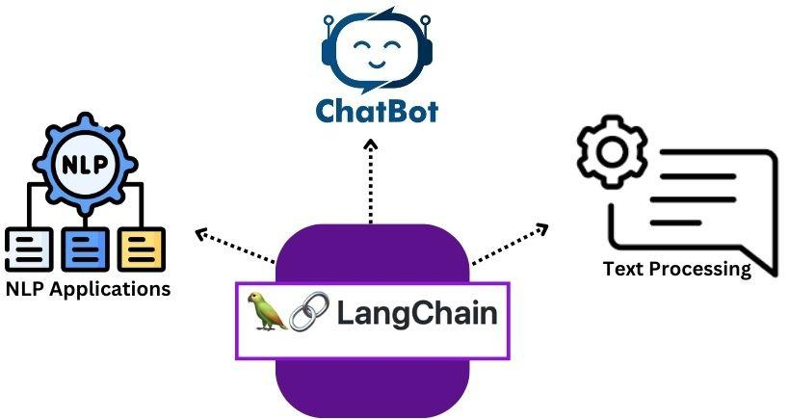
Use Cases
Useful for building chatbots, automated text
processing pipelines, and other NLP applications.

Slide 25
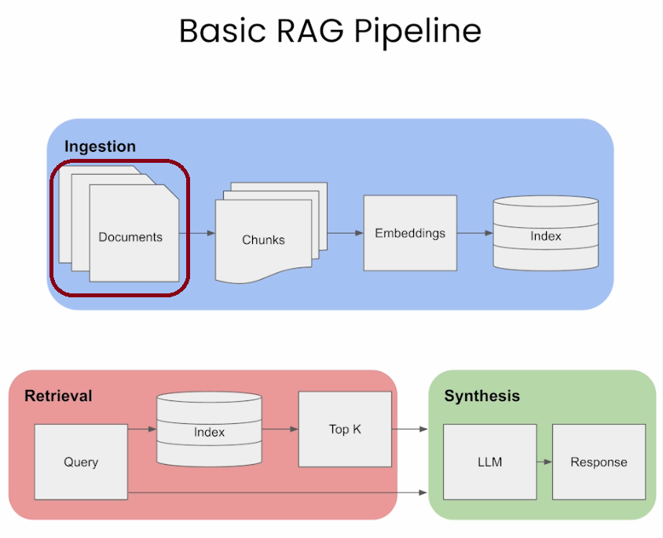
Step 1: Document Loading

Slide 26

Document Loading
Document Loading: The process of ingesting
documents into a system for further processing.
Supported Formats: Includes plain text, HTML,
docs, PDF, and more.

Slide 27
Document Loading
Techniques:
Use of specific loaders for different
formats, handling large documents, and
maintaining document integrity.

Slide 28
Document Loading
Applications:
Preparing data for NLP tasks,
ensuring compatibility with various text
processing tools, and efficient handling
of diverse document types.

Slide 29
Demo

Slide 30






Summary
RAG
Langchain
Document Loading
‹#›

